Slide 1


Advanced Continuous Multi-Face Tracking and Monitoring System
Presented by:
Udit Sethi - 2001EE93
Guided by:
Prof. Jawar Singh

Slide 2
Broad Outline
Overview of System
Flow Chart
Database
Demonstration
Result
Conclusion
Future Scope
References
Introduction
What is Multi-face Tracking?
Why Multi-face Tracking?
Problem Statement
Literature Survey
Step-by-Step Analysis
Multiple Face Tracking

Slide 3
Introduction
In this presentation, we will explore how to design and implement a cutting-edge system that leverages different technologies and tools to continuously track and monitor multiple faces.
We will discuss the importance of this system in various applications and industries.
We will delve into the objectives, components, technical challenges, and implementation of this system, highlighting its importance and potential impact on various industries.
The objectives of the system:
Locate multiple faces in real-time.
Identify the faces with the database.
Ensure robustness and accuracy.
Implement a user-friendly interface.

Slide 4
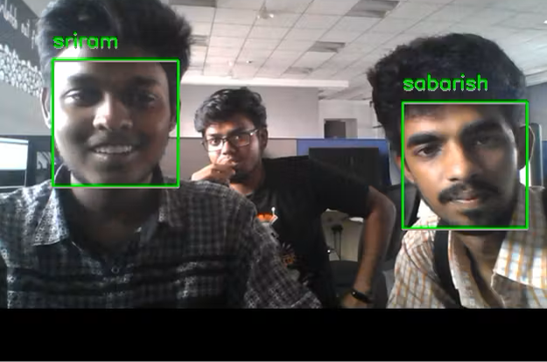
What is Multi-Face Tracking?
It is a computer vision and machine learning technique that involves the real-time tracking and monitoring of multiple human faces within a video stream or series of images.
Some key aspects of multi-face tracking:
Face Detection
Face Tracking
Real-Time Processing
Handling data

Slide 5
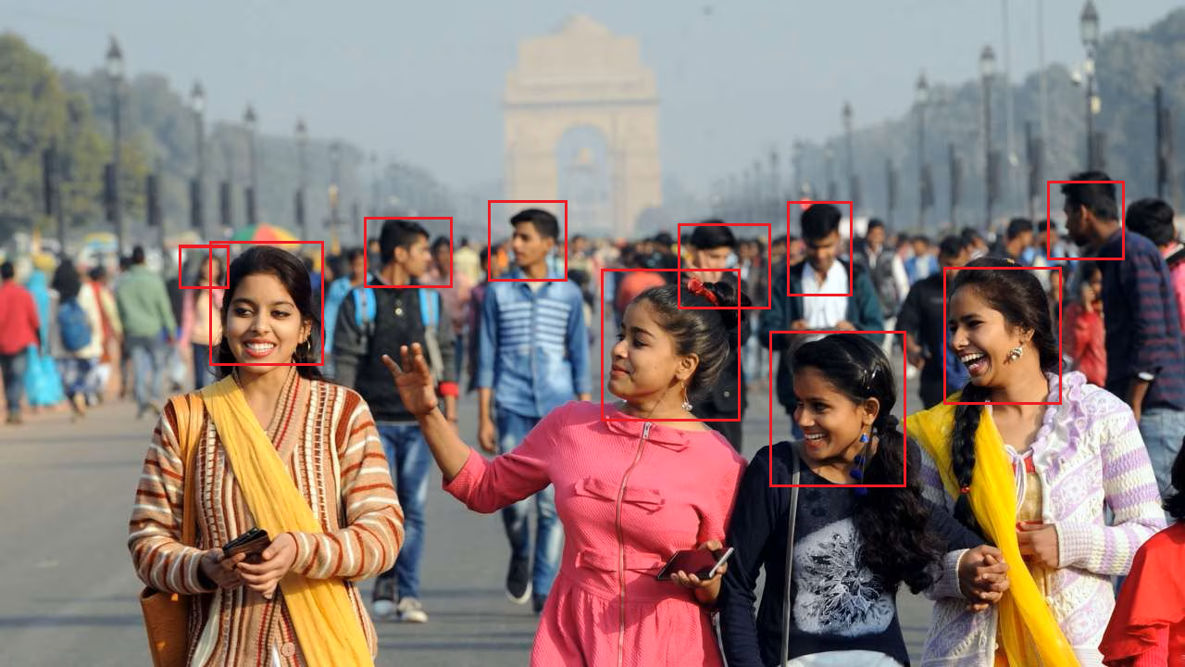
Why Multi-Face tracking
Multi-face tracking has a wide range of applications, including:
Surveillance and Security
Locating Individual
Social Media and Photo Tagging
Access Control

Slide 6
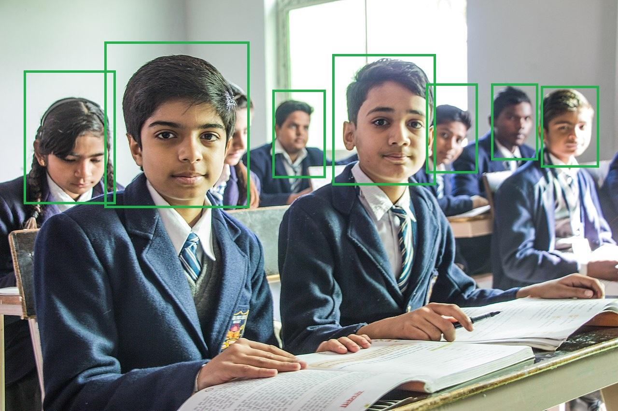
Problem Statement
Advance Attendance System:
In a classroom setting with a large number of students, such as 100 or more, efficiently and accurately marking their presence simultaneously poses a significant logistical challenge.
Therefore, there is a need for an automated and streamlined solution to mark the presence of a large number of students simultaneously in live classroom sessions.

Slide 7
Literature Survey
Approach | Method Name | Summary | Limitations
[2] | Dlib-HOG | Dlib algorithm used in this paper gives the best solution for face recognition. This face alignment technique describes the process involved in feature extraction using Convolutional Neural Network and face recognition of digital images. | Turned faces or partial face detection is not accurate. Doesn’t work on non-frontal images, doesn’t work under occlusion. Can’t detect small faces and need some optimisation.
[4] | PCA | The PCA method has been extensively applied for the task of face recognition. Approximate reconstruction of faces in the ensemble was performed using a weighted combination of eigenvectors (Eigen pictures), obtained from that ensemble | If w decreases with non-negligible ratio as z does, then PCA fails to reproduce the original behavior of w. ... Also, time varying w can be confused with the incorrect value of constant one when the decreasing (or increasing) ratio of w is small but not negligible | -

Slide 8
Step-by-Step Analysis

Slide 9
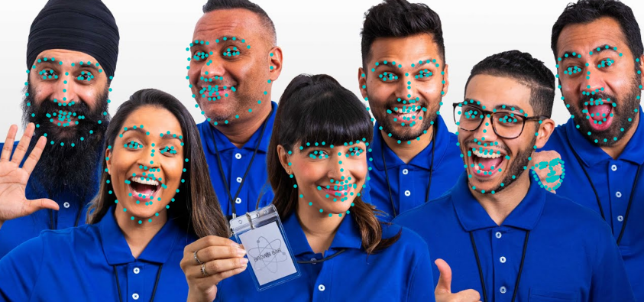
Face Detection
We need to locate all the faces in a frame. I’m going to use a method called Histogram of Oriented Gradients (HOG).

Slide 10
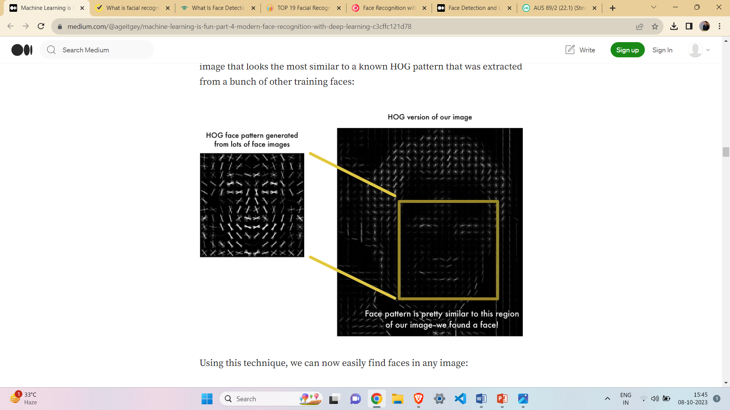

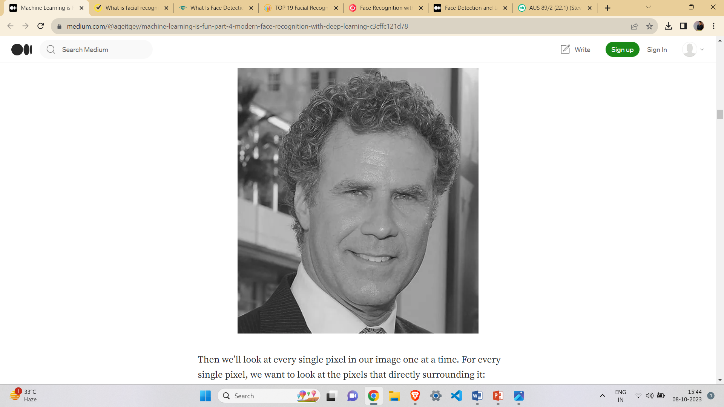
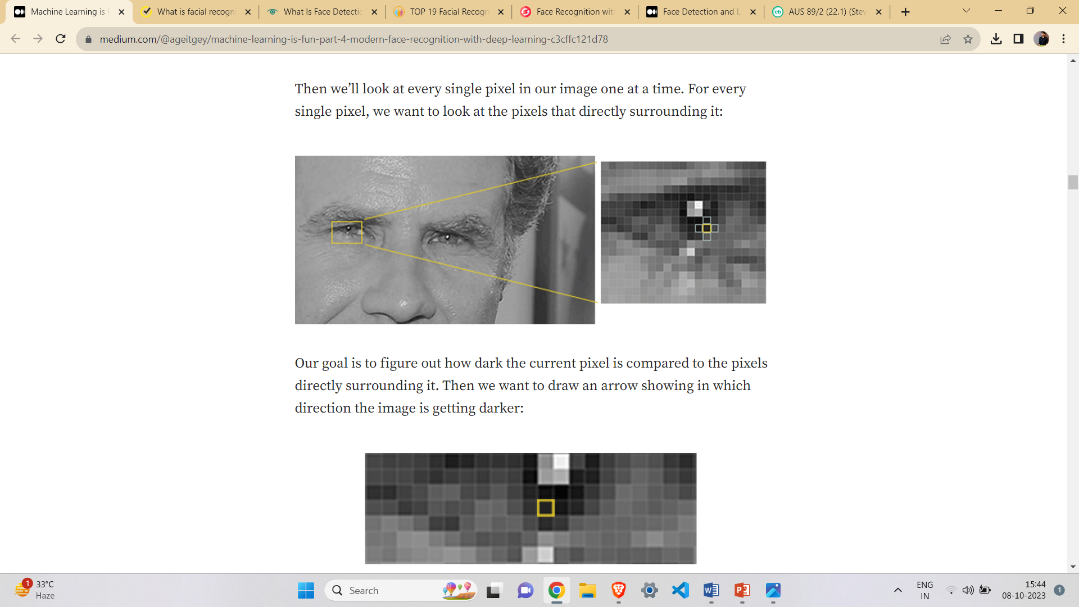
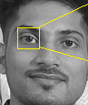
Histogram Oriented Gradients
Black and White image
16x16 pixels
Simple representation that captures the basic structure

Slide 11
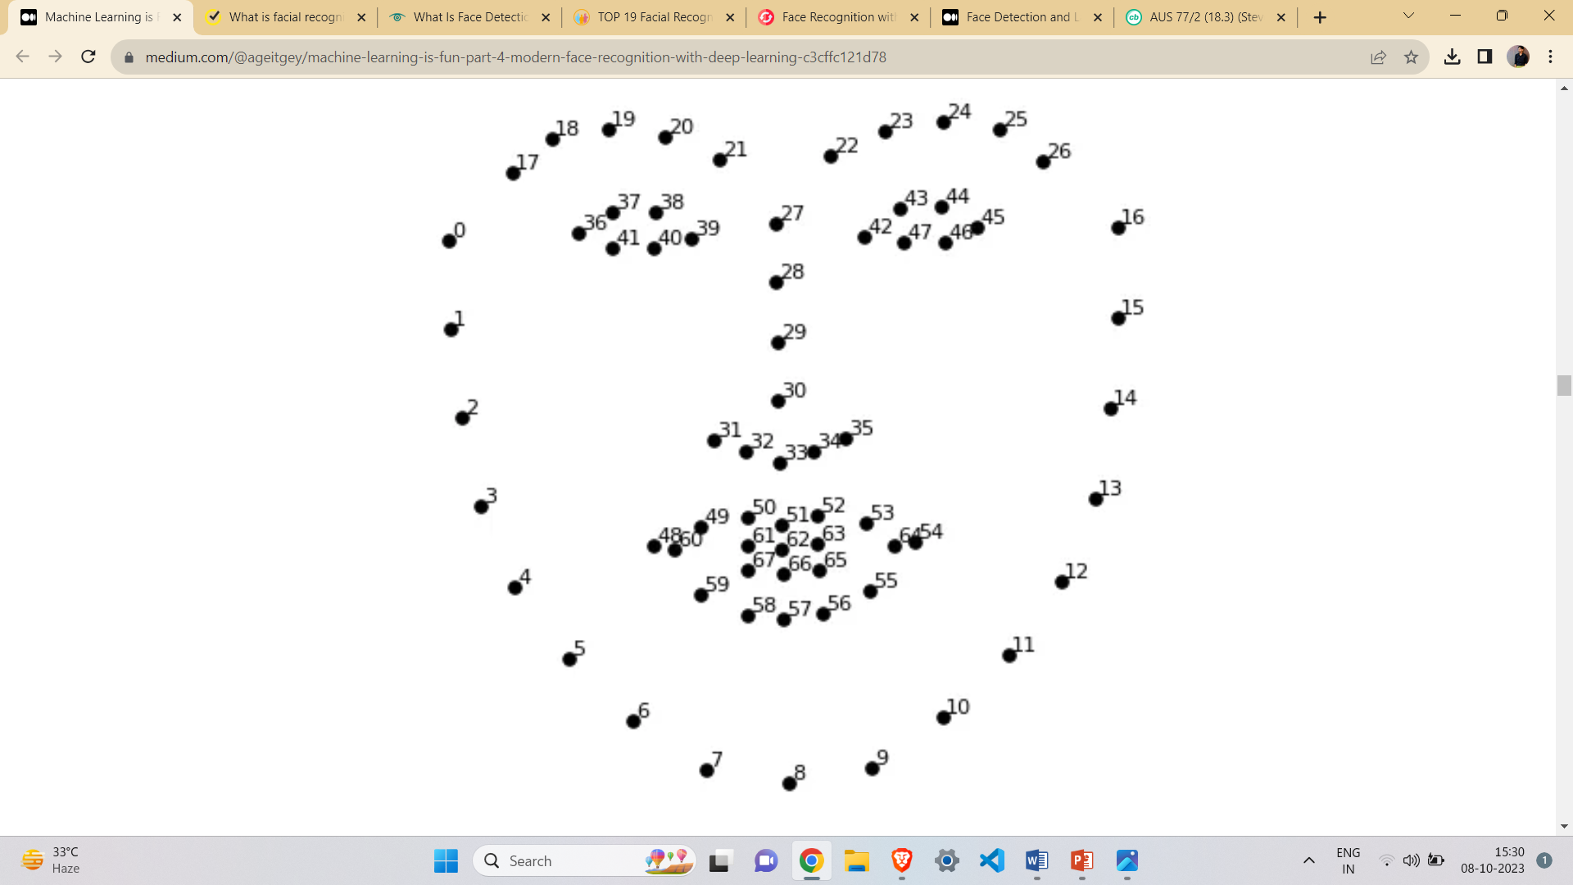
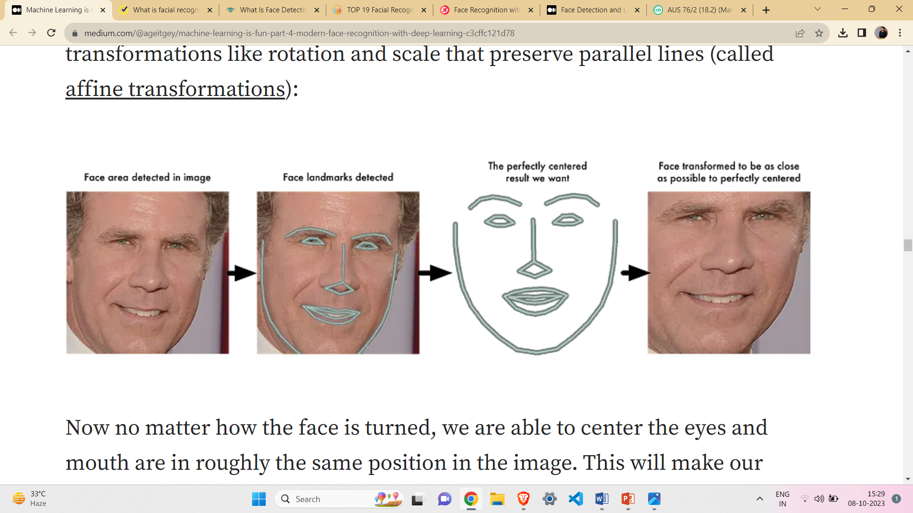

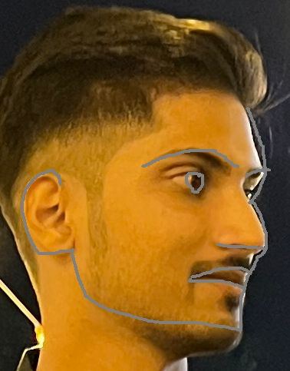
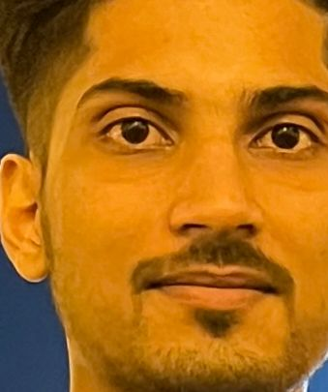
2. Face landmark association
The faces turned different directions look totally different to a computer, to overcome this issue, I’m using face landmark estimation technique.
The basic idea is we will come up with 68 specific points that exist on every face.
Then we will train algorithm to be able to find these 68 specific points on any face.

Slide 12
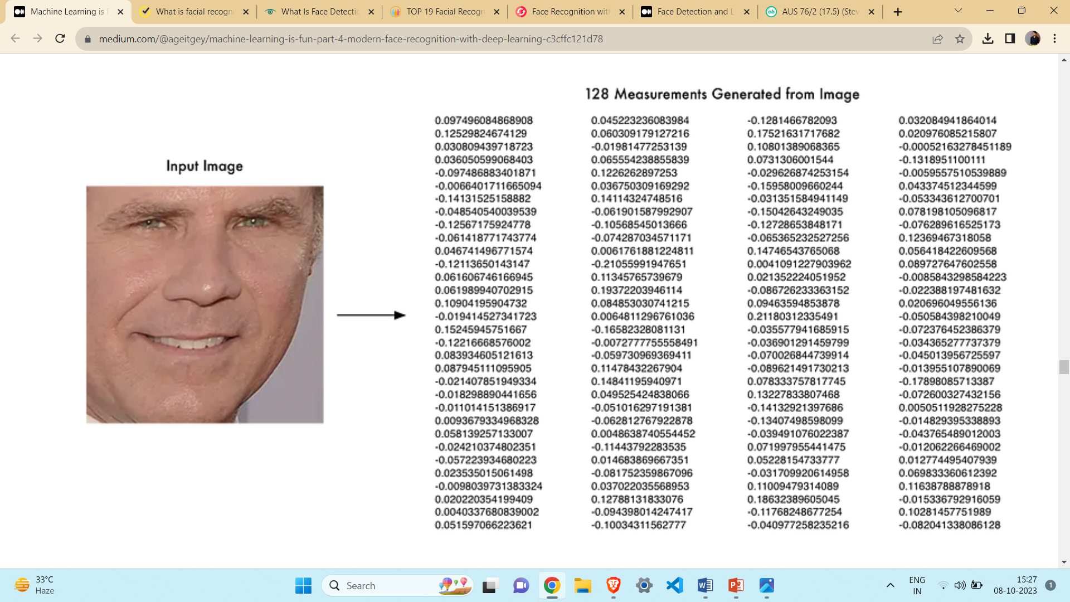

3. Face Encoding
Face Encoding is done by designing a Deep Convolutional Neural Network and train it to generate 128 measurements for each face we find by HOG.

Slide 13
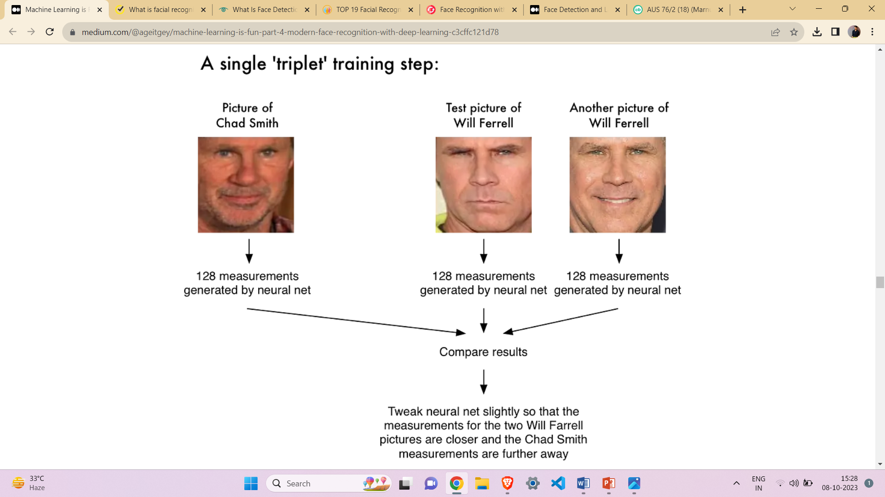


4. Decision Making
By using Triplet training algorithm or Support vector machine classification algorithm. We can align the detected face to the relevant database faces.
Picture of Udit
Picture of Yash
Another Picture of Udit…………
Tweak neural net slightly so that the measurements for the two Udit pictures are closer and the Yash measurements are further away……………………………….

Slide 14
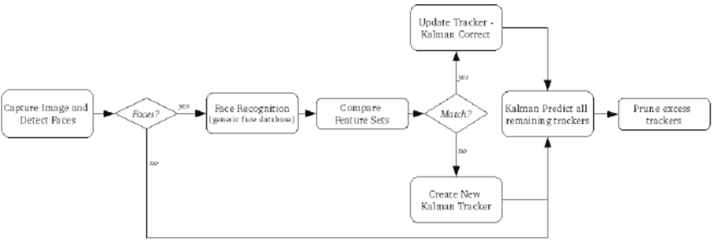
Multiple Face Tracking
Multiple face tracking is performed by modelling and tracking each face independently until the occlusion occurs among two or more faces.
Occlusion occurs when two or more faces occlude each other. Occlusion handling is one of the main challenges in multiple face tracking algorithms.
To implement simultaneous tracking of multiple faces, a robust face detection algorithm is crucial, and employing deep learning-based detectors Addressing challenges related to face occlusion and overlapping by utilizing advanced tracking methods and integrating depth information, if available, further enhances tracking accuracy.
Optimizing the code for parallel processing, leveraging hardware acceleration like GPUs, and dynamically managing faces entering or leaving the frame contribute to performance optimization.

Slide 15
Overview of System
The application primarily aims to establish a real-time system applicable to diverse real-world environments where numerous technical systems necessitate seamless human-computer interactions.
Leveraging various cameras integrated into everyday living and working spaces, the system operates by taking video input through a webcam.
The image data from each video frame undergoes a series of preprocessing steps, encompassing normalization, gradient computation, and integral image calculation. Face detection is a foundational step, serving as the underpinning for subsequent face tracking and recognition.
Employing the HOG (Histogram of Oriented Gradients) algorithm, the face recognition technique discerns and identifies faces within the video frame.

Slide 16
Flow Chart
Start
Start
Open Camera
Match the generated encodings with the database
Load the student image from the database
Read Frame/Image
Generate face and coding
Mark the attendance and update the database
Detect the different faces from frame
Save all encodings
Generate the encodings of the detected face

Slide 17
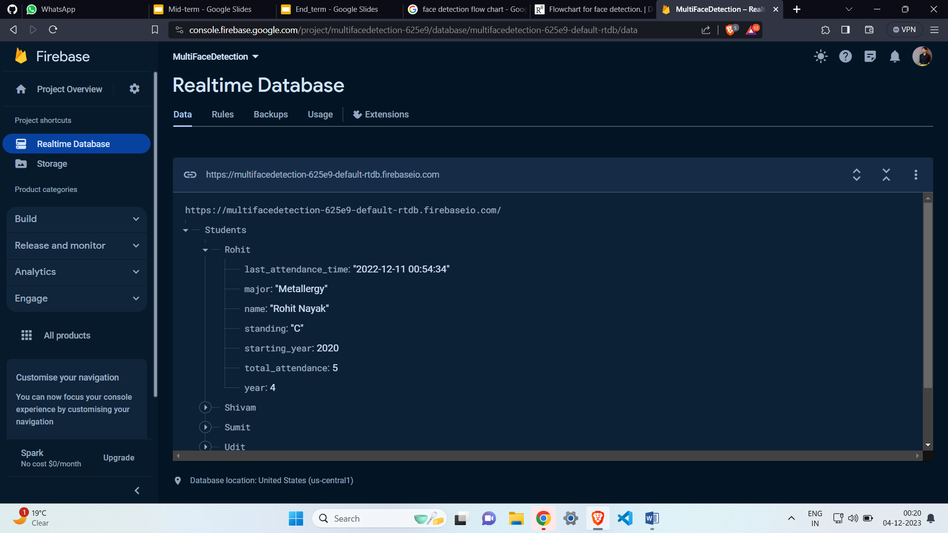
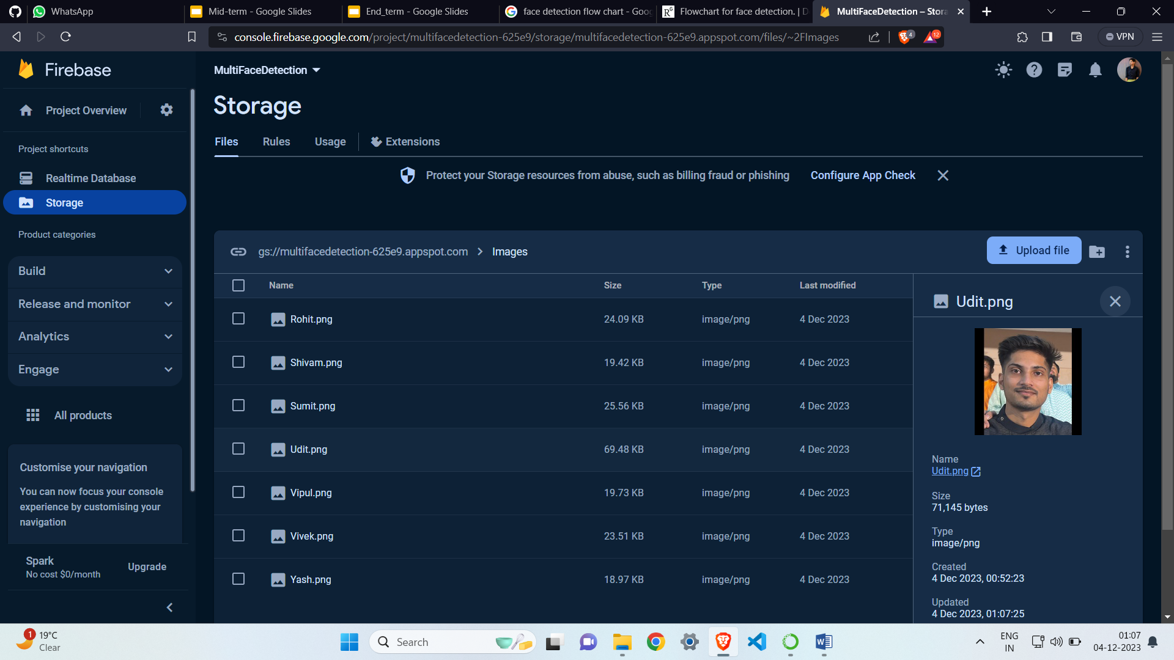
DATABASE
To update and track the students attendance details, Firebase is used.
Firebase ensures that attendance records are instantly updated and accessible. This enables seamless monitoring of students' presence, providing educators with timely and accurate information.

Slide 18
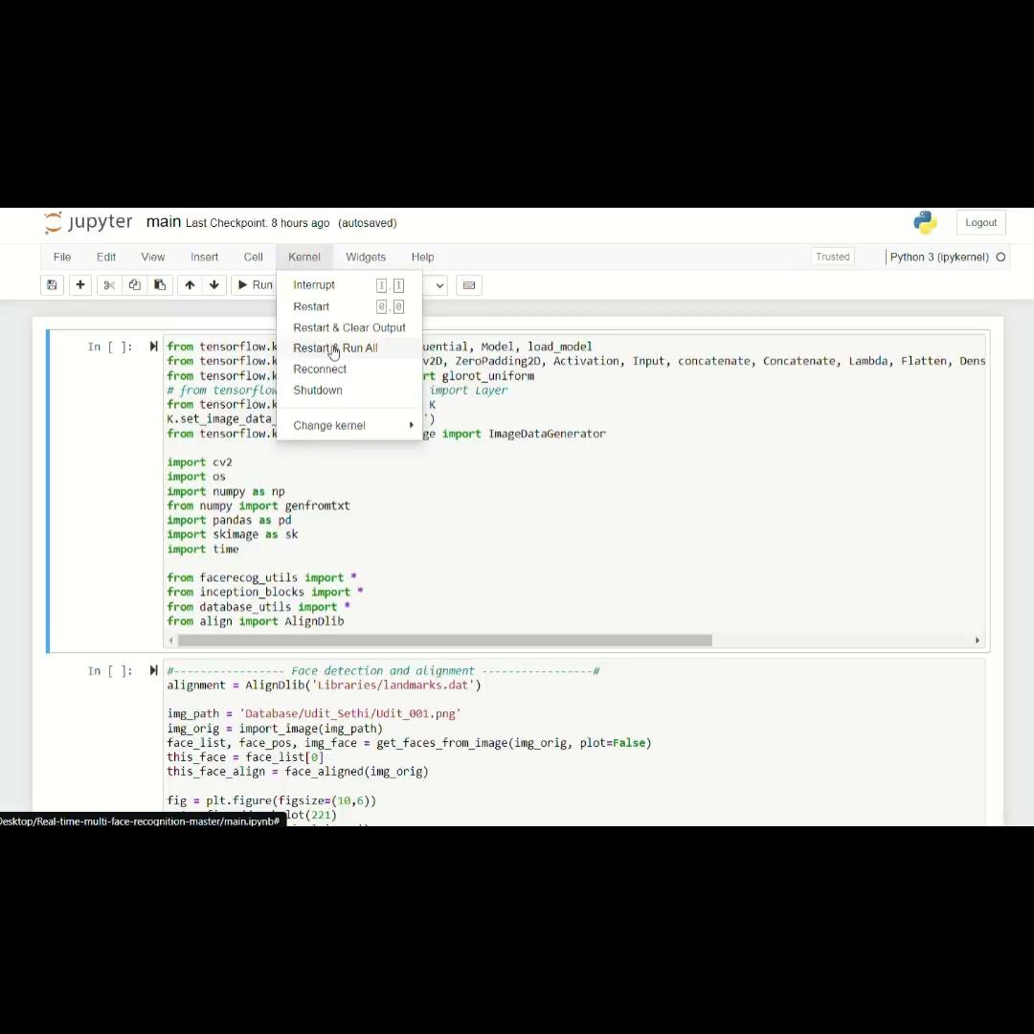
DEMONSTRATION
https://drive.google.com/file/d/1oOy3kX7uK0VO-f7OiSnPeiIjE_TrO61q/view?usp=drive_link

Slide 19
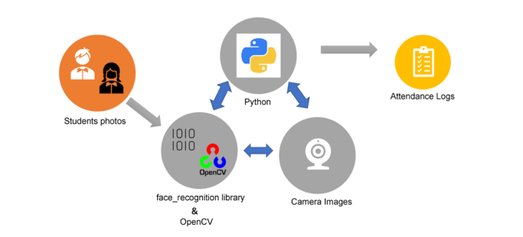
Result
The above solution has been implemented to build a software that works on both live and recorded videos. When the software is running, a user may intervene at any time to tag a detected face in a frame. A feature vector of the tagged face is then computed and saved in the trained image folder for different variations in pose, illumination ,distances etc. The training data default location is within the Trained Faces folder of the application path. It has a single XML file that contains tags for the name of the person and a file name for the training image. However, due to the lack of standard benchmark videos, it is unpractical to compare detection accuracy with prior arts.

Slide 20
Conclusion
In this paper, a human detection and recognition system for real time use cases was presented.
First, the faces are detected in the video frames by using HOG algorithm.
To remove the outliers from the detected face region, we design a face landmark estimation technique to get feature points detection and extraction.
As the face tracking is going on, faces are simultaneously recognized by the trained classifier (support vector machine).
All this process is carried out through a python script.
The script integrates face recognition algorithms, to create a system for tracking attendance and displaying student information in real-time. The logic is quite complex, and specific for the students enrolled.

Slide 21
Future Scope
Further research will be required in a number of aspects to improve this work.
First, video processing pipeline can be used that integrates the image processing modules.
Second, a solution will be required for dealing with large number of images in trained folder.
Third, human body detection and tracking will be integrated into the system so that face and body information can be used together.
Fourth, improved multi face tracking system needed to be implemented for detecting large no. of faces simultaneously with effective hardware needs.

Slide 22
Thank You
References
[1] https://ieeexplore.ieee.org/stamp/stamp.jsp?tp=&arnumber=9523885
[2] https://ieeexplore.ieee.org/stamp/stamp.jsp?tp=&arnumber=7831628 [3] https://ieeexplore.ieee.org/stamp/stamp.jsp?tp=&arnumber=9523885&tag=1
[4] https://ieeexplore.ieee.org/stamp/stamp.jsp?tp=&arnumber=9145558

